Slide 1

Advance Web Scraping and Search
Group No 7:
Sajida Malik
Matthew Grafals

Slide 2
Contents:
Project Goals
Methodology
Results
Search Engine
Demo

Slide 3
Project Goals:
Develop a robust data ingestion engine capable of advanced web scraping techniques.
Refine search queries to enhance the relevance of search results
Implement sophisticated data extraction methods to capture and process this data effectively.
Create a structured database to store and manage web data
Deploying a user-friendly web browser interface.
Interface allows users to input their search queries.
Sorts and displays results based on data relevance and frequency.

Slide 4
Methodology:
Database “My Custom Bot” Creation
Web Scraping
Store and Display the Cleaned URLs
Store and Display the Frequencies
Minimizing Scraping Volume
Removing Duplicates
Create a Search Engine

Slide 5
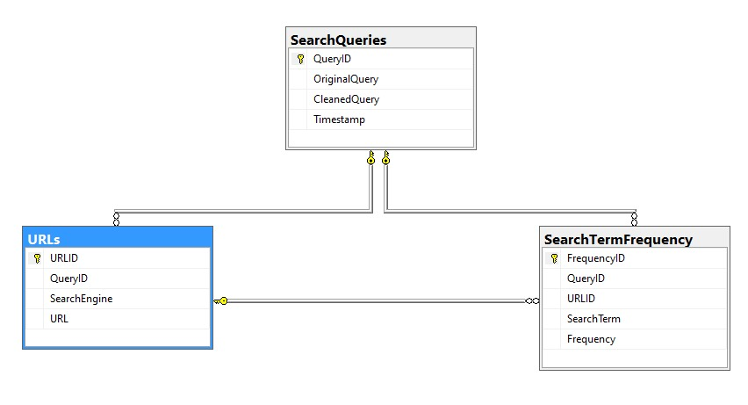
Database: My Custom Bot

Slide 6
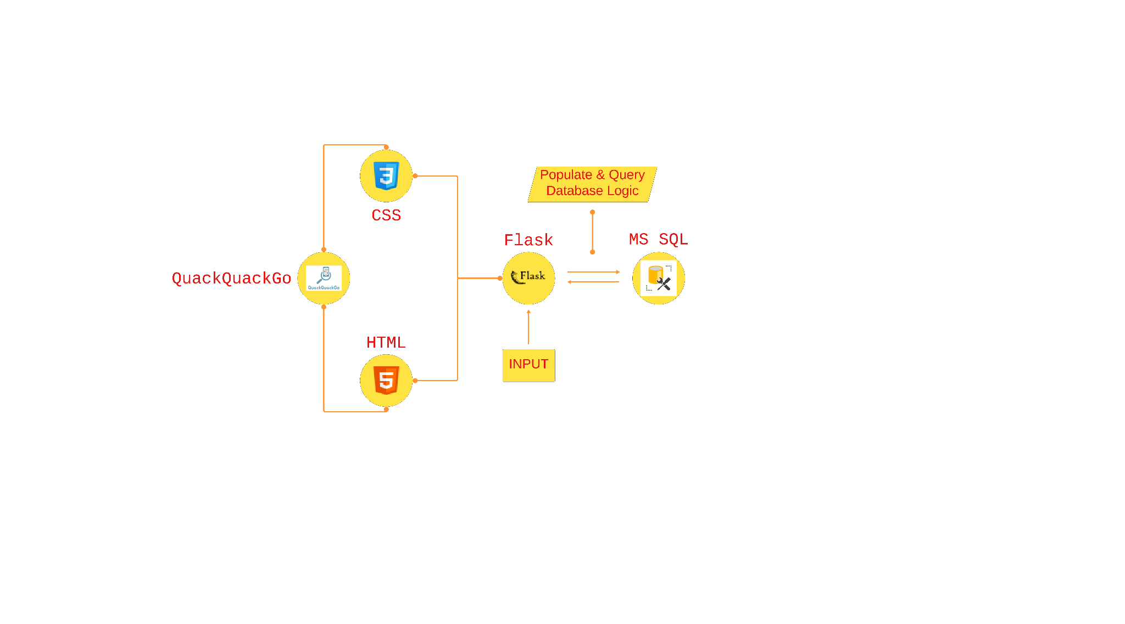
Search Engine Architecture

Slide 7
Tools and Libraries Used:
Selenium - allows connection to chrome web browser, reduce resource usage, & speed up execution.
Beautiful Soup - used to pull raw html content from search engine webpage
Nltk - used to import & remove stop words
Re - used to remove punctuation marks
Pyodbc - used to connect python file to SQL server
Flask - used to create web framework

Slide 8
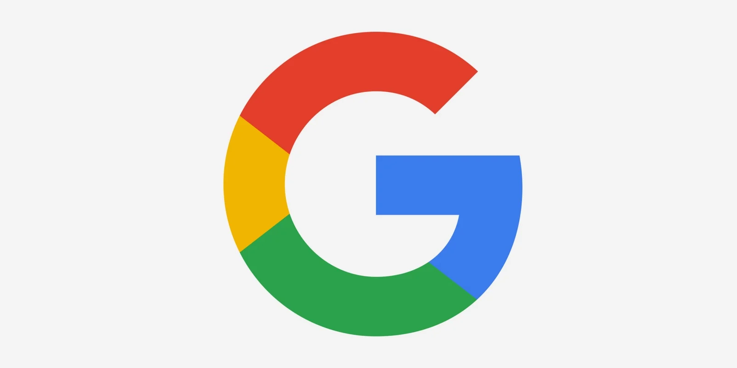
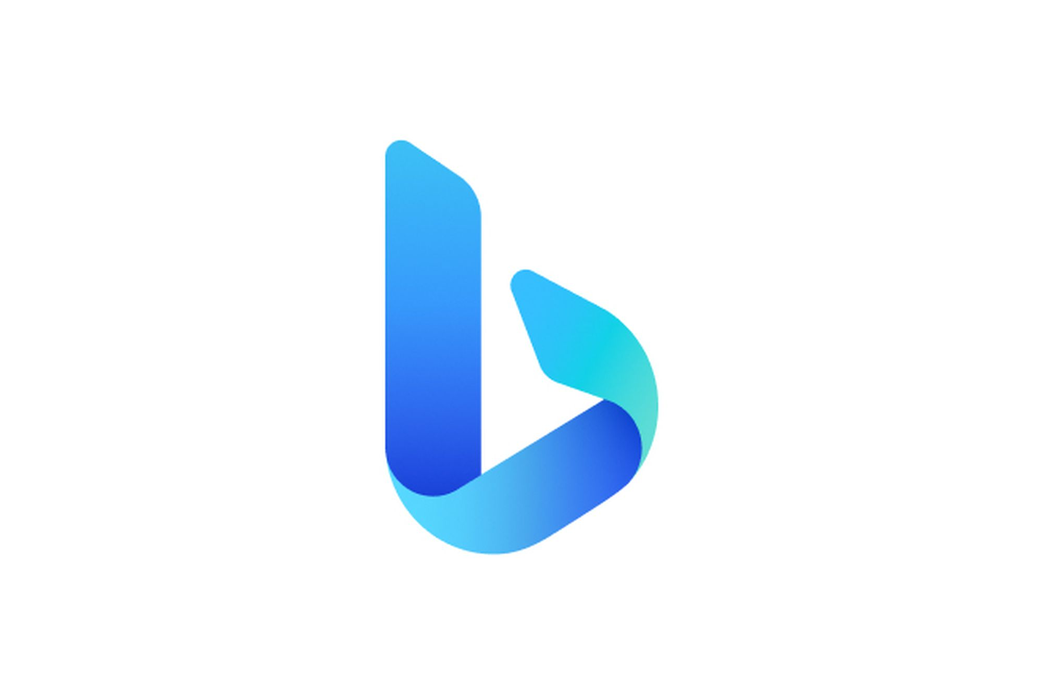


Search Engines:
Google
Bing
Duckduckgo
Yahoo

Slide 9
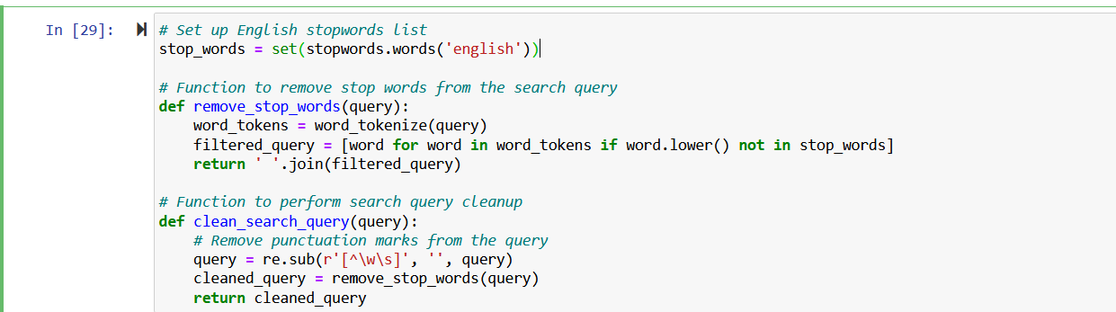
Removal of Stopwords:
List of stopwords is downloaded by the imported function “nltk”.
In “remove_stop_words” function, search terms in our query are tokenized to verify if they exist in the list of stopwords and rejoined into a string.
The “clean_search_query” function utilizes the imported “re” function to remove any punctuation marks in our query string.
After both steps, we are left with a cleaned query search.

Slide 10
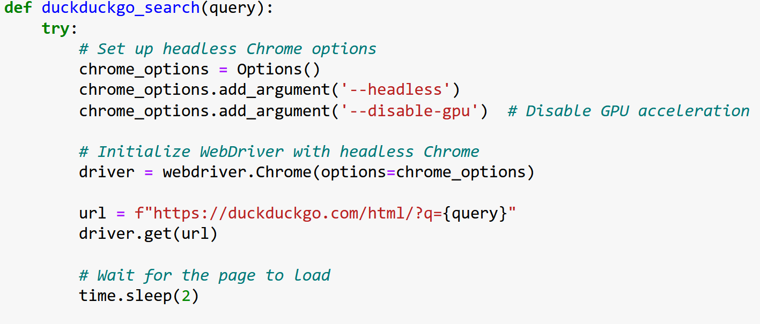
Web Scraping:
Minimizing Scraping Volume to Avoid Detection
Selenium’s chrome webdriver “Options()” function is imported to connect to Google web browser.
The “headless” parameter argument helps reduce the likelihood of being blocked when scraping or automating web tasks.
The “disable-gpu” parameter argument reduces compatibility issues and improves stability.
The “time.sleep(2)” function allows us to delay requests to simulate human behavior.

Slide 11
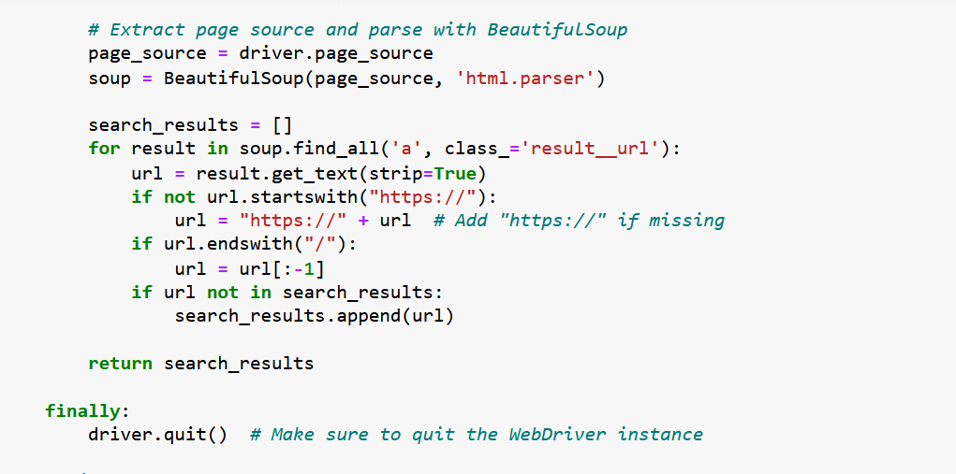
Eliminating Duplicates and Advertisements:
Initializes a headless Chrome WebDriver: Sets up and runs a headless Chrome browser for automated browsing.
Performs a Google search: Constructs a Google search URL with the provided query and retrieves the search results page.
Extracts and returns search results: Parses the page source with BeautifulSoup to extract and return URLs of search results.

Slide 12
Search Query Table Results:
Search Query
QueryID | Original Query | Cleaned Query | Timestamp
1 | Childhood cancer treatment best hospitals USA | Childhood cancer treatment best hospitals USA | 5/8/2024 18:49
2 | Childhood cancer treatment best hospitals USA | Childhood cancer treatment best hospitals USA | 5/8/2024 18:57
3 | Childhood cancer treatment best hospitals USA | Childhood cancer treatment best hospitals USA | 5/8/2024 19:09

Slide 13
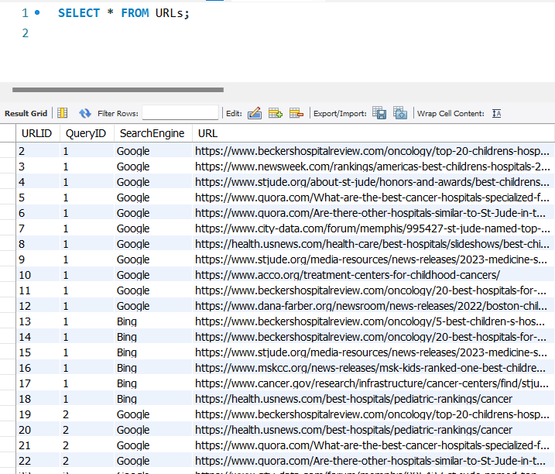
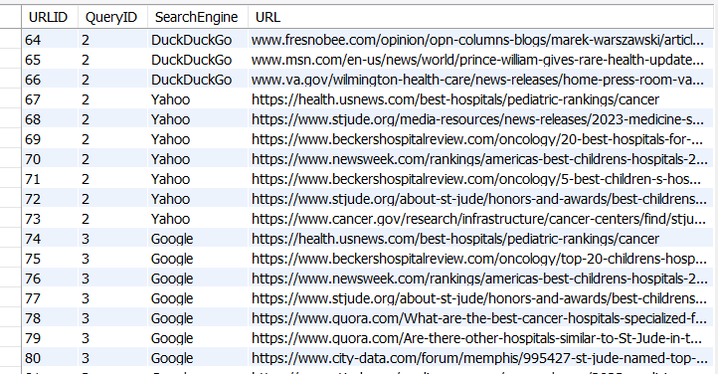
URLs Table Results:

Slide 14
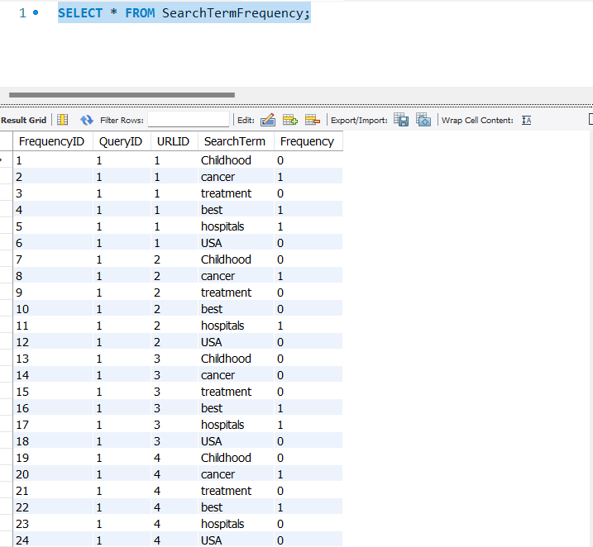
Search Term Frequency Table Results:

Slide 15
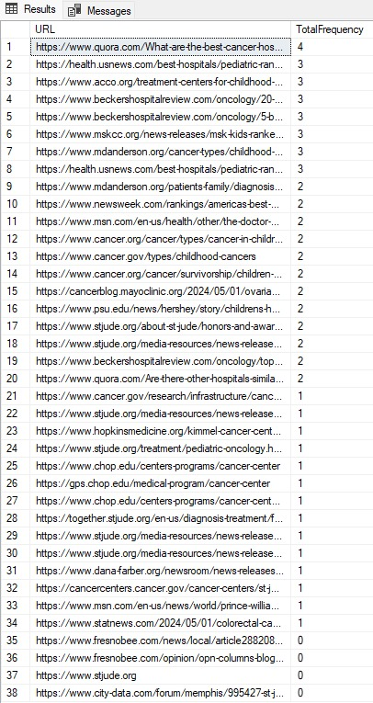
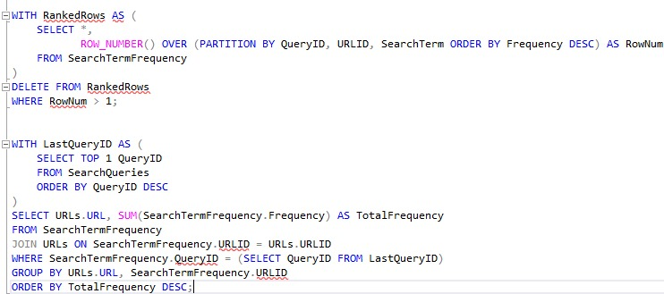
Sorted Total Frequency Counts:

Slide 16
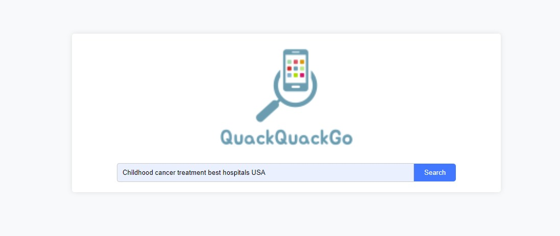
Search Engine:

Slide 17
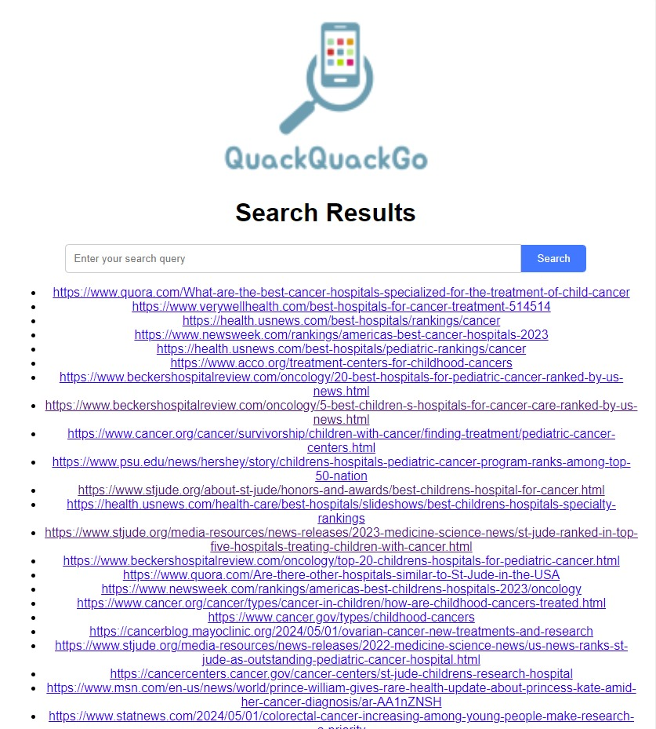

Slide 18

Web Scraping Demonstration:
Video demonstration is saved on Google Drive.
If not playable, ctrl + left click to follow link.

Slide 19
Thank You!
Group 7: Matthew Grafals & Sajida Malik

